Slide 1


Data Representation
Gabriel Avelino Sampedro, Ph.D.
Chairman, Korean Institute of Communications and Information Sciences - PH Section
Founder / CEO, Philippine Coding Camp

Slide 2



DATA
Real-world data must be represented into a data structure to
apply computer algorithms for analysis.
Real-world Data
Data Structure Representation

Slide 3
DATA REPRESENTATION

Slide 4
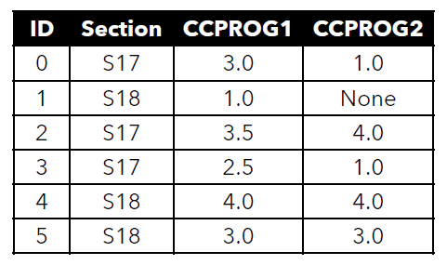
DATA REPRESENTATION
A data matrix is a common representation of data

Slide 5
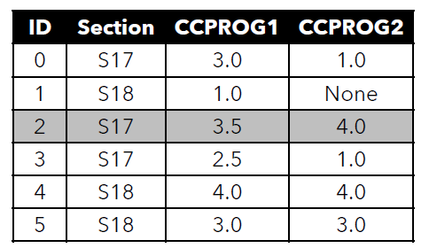
DATA REPRESENTATION
Each row is a single observation in the dataset.

Slide 6
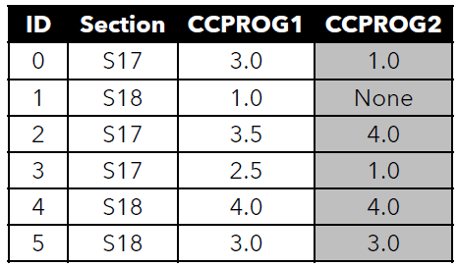
DATA REPRESENTATION
Each column is a variable, which represents a characteristic of each observation.

Slide 7
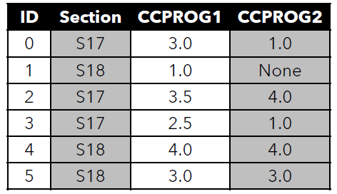
DATA REPRESENTATION
Each variable is of a certain type of data.

Slide 8
DATA REPRESENTATION
pandas (panel data) is a Python package designed for analysis of tabular data represented as vectors and matrices.

Slide 9

DATA REPRESENTATION
pandas works seamlessly with other data science libraries for Python.

Slide 10
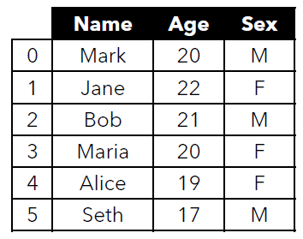
DATA REPRESENTATION
DataFrame
The primary pandas data structure.
Two-dimensional, size-mutable, potentially heterogeneous tabular data.

Slide 11
DATA REPRESENTATION
DataFrame
Data structure also contains labeled axes.
Arithmetic operations align on both row and column labels.
Can be thought of as a dict-like container for Series objects.

Slide 12
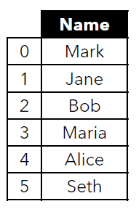
DATA REPRESENTATION
Series
One-dimensional ndarray with axis labels.
Labels do not need to be unique.
The object supports both integer- and label-based indexing.
Operations between Series align values based on their associated index values – they do not need to be of the same length.

Slide 13
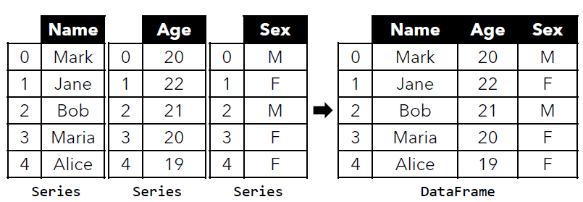
DATA REPRESENTATION
A DataFrame is a combination of multiple Series.

Slide 14
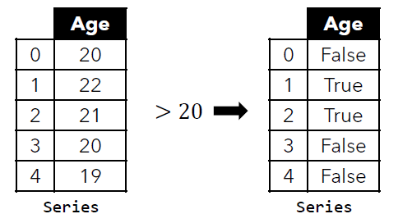
DATA REPRESENTATION
Applying an operation on a Series by a scalar performs the operation on each member of the Series.

Slide 15
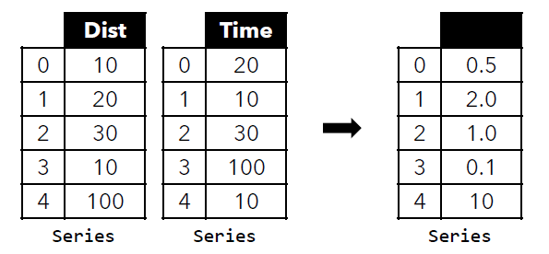
DATA REPRESENTATION
Applying an operation on a Series and another Series performs the operation element-wise.

Slide 16
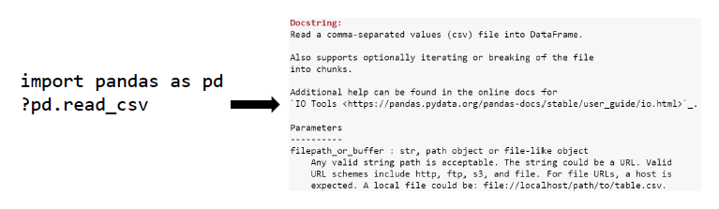
DATA REPRESENTATION
You can use ? In Jupyter for any function to quickly view its documentation.
For example, to find out how the read_csv function works:

Slide 17
BASIC OPERATIONS

Slide 18
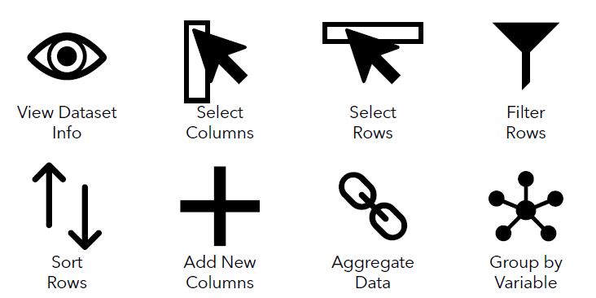
BASIC OPERATIONS

Slide 19
BASIC OPERATIONS
View Dataset Info
View dataset information such as the variables, the datatype of each variable, the number of observations, the number of missing values, and other information

Slide 20
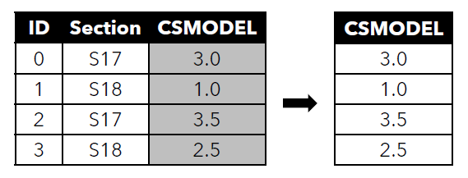
DATA REPRESENTATION
Select Columns
Select CSMODEL column as a Series

Slide 21
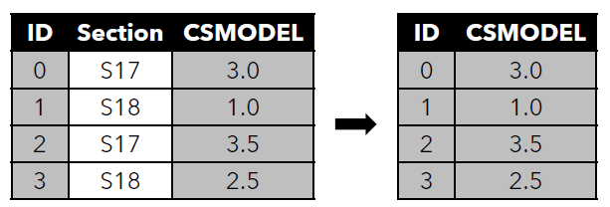
DATA REPRESENTATION
Select Columns
Select ID and CSMODEL columns as a DataFrame.

Slide 22
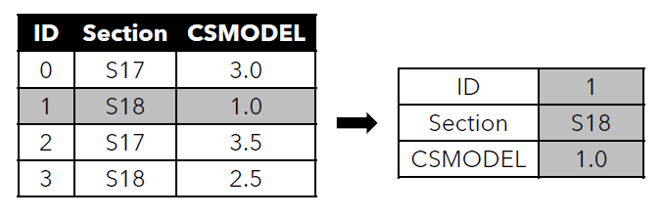
DATA REPRESENTATION
Select Rows
Select the second observation as a Series.

Slide 23
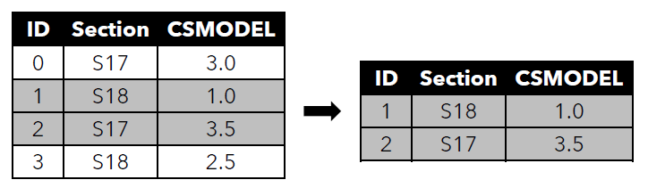
DATA REPRESENTATION
Select Rows
Select the 2nd to 3rd observations as a DataFrame.

Slide 24
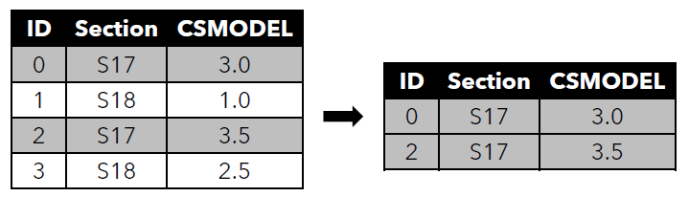
DATA REPRESENTATION
Filter Rows
Select observations where CSMODEL
grade is 3.0 or above.

Slide 25
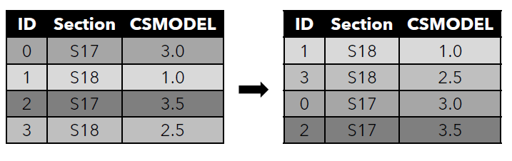
DATA REPRESENTATION
Sort Rows
Sort observations according
to CSMODEL grade.

Slide 26
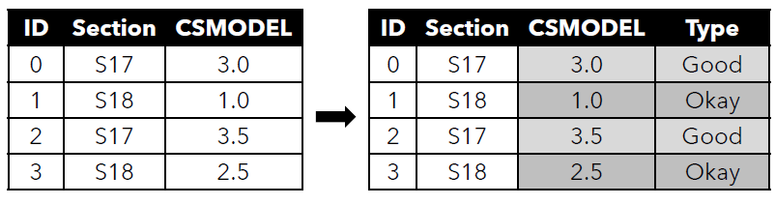
DATA REPRESENTATION
Add New Columns
Add new column “Type” where the value if “Good” if CSMODEL grade is at least 3.0 and “Okay” otherwise.

Slide 27
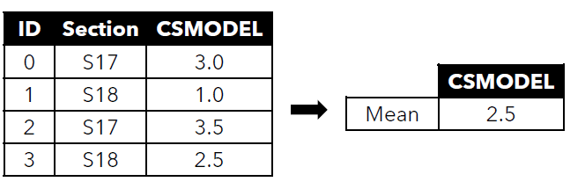
DATA REPRESENTATION
Aggregate Data
Get the average for column CSMODEL.

Slide 28
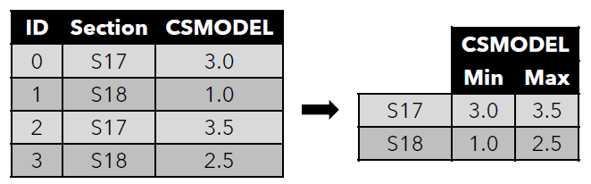
DATA REPRESENTATION
Group by Variable
Group the data by section. Then, get the min and
max grade per section for CSMODEL.

Slide 29
Thank you for listening!
Let’s Connect:
Gabriel Avelino Sampedro, Ph.D.
garsampedro@ieee.org
WhatsApp: +63 999 992 9515

